Slide 1
Sixth Form candidates for Senior Student

Slide 2
Alex Mills

Slide 3
Vote for me! Sixth Form senior leader!
Why?
Chicken Curry Panini's
Improved tea-bags
Widened variety of food outlets
Chips on a Wednesday?
WHATEVER YOU WANT, I’LL GET IT
ALEX MILLS – SENIOR LEADER

Slide 4
Will Price-Green

Slide 5
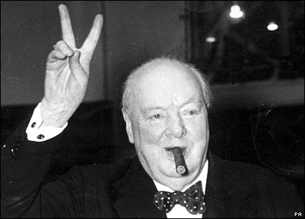
Bacon Sarnies in the Sixth Form and improved bacon in the school, possibly tomato sauce.
No locking of the door in the small quad, saving you walking all the way around.
More responsibility for older students.
Allowed to take your meals out of the restaurant in cartons for older students.
Workload changed to prepare for A levels.
My main aim is to change Southmoor Academy/Sixth Form into a more social and respectable place, to make both student and teacher happy.
My second aim is to be as approachable and friendly and open to ideas as possible.
Finally, my last aim is to give pupils a sense of independence and maturity.

Slide 6
Josh Mather

Slide 7
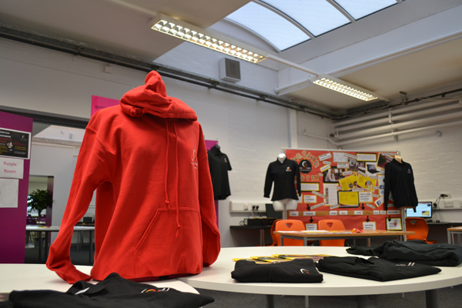
Vote for me!
Sixth Form Senior Leader Josh Mather
Organise any clubs and events you want in place prior to coming to sixth form
Bridging the gap between pupils and senior management
Sort out the dinner queues THIS year
I will be the voice for collective ideas
Create a system to help prepare you for sixth form
What do you want?

Slide 8
Humayra Siddika

Slide 9
Student Democracy – ‘LET YOUR VOICE BE HEARD’
“I want the Sixth Form to be, first and foremost, about the student body”
What I promise to do as Senior Leader is:
To make sure that if you want anything done, changed or added to the Sixth Form, I will take your suggestions to the Head and make sure that your opinion is heard and something is done about it.
To make the transition days an accurate and a true representation of what your chosen course will entail so you know what to expect.
R&R DAY
This will take place at the end of each term, where the Sixth Form has a day off timetable where we organise a day of fun & games, which will take place in each of the Sixth Form rooms.
Vote: HUMAYRA SIDDIKA

Slide 10
Jess Lewandowski

Slide 11
VOTE JESS LEWANDOWSKI…
…TO ENSURE A MEMORABLE SIXTH FORM EXPERIENCE.
WE LOVE SOUTHY.

Slide 12
James Carney

Slide 13
Why vote for James?
I will:
Arrange changes that you want in the sixth form for when you enter. I will be the direct voice to senior management.
Promote subjects that aren’t already on the sixth form curriculum that you may be interested in.
Support you in the leap from GCSE to A-level (through arranged transition days and meetings with teacher and pupils.)
Organise for clubs that you take part in at the moment to continue into the sixth form (e.g. the football team).
Sort out a system so that sixth formers aren’t pushing in front of you in the dinner queue. (more food outlets)
Always be approachable and ready to hear any other ideas or issues you have.

Slide 14
Connor Hardy

Slide 15
He is the Man
4 The JOB
Vote 4 Connor
He is your Voice,
Your Eyes and Your Ears
I will listen to
what you have to say
Vote 4 Connor to
Be your SENIOR STUDENT

Slide 16
Tabitha Bonallie

Slide 17
Vote Tabitha for Student Leadership
What ideas do you have?
What subjects do you want to study?
What changes do you want to see?
What food do you want to eat?
Its your 6th Form too, help make it what you want

